Slide 1
//////////
//////////

Slide 2
///// ABOUT /////
HOW IT WORKS
The program is designed to be a 2-year program with focus on three main things: leadership skills, formation of the character of Christ, and an intimate relationship with the Father and His Word. We train and invest in the student’s leadership skills by equipping and challenging them to lead Life Groups and make disciples.
IS VSM FOR YOU?
VSM is for the called and it is not for the faint of heart. It’s a fast paced season of schooling and you must be ready and willing to invest much time and energy. Besides normal school hours and classes, students have daily assignments, weekly outreaches, and Life Group meetings.
CLASS SIZE
Class sizes are expected to be about 15-25 students.

Slide 3
///// STUDENT HOUSING /////
STUDENT HOUSING
Vine School of Ministry and Vine Church are located in the city of Margate, in South Florida. Student housing is available for an additional fee based upon availability. Student housing provides the opportunity to have convenient living arrangements while attending Vine School of Ministry. Students are able to build strong relationships within the student housing community and gain the full experience of student life.
ADDITIONAL HOUSING FEE
Housing fee is $4,200/Year or $350/mo for 12 mos.*
*Not including the tuition fee,
DOES NOT INCLUDE
It is important to know that the additional student housing fee does not cover any food expenses, furniture (except for a bunk bed and mattress) or toiletries needed accordingly. Each student is fully responsible for his/her self.

Slide 4
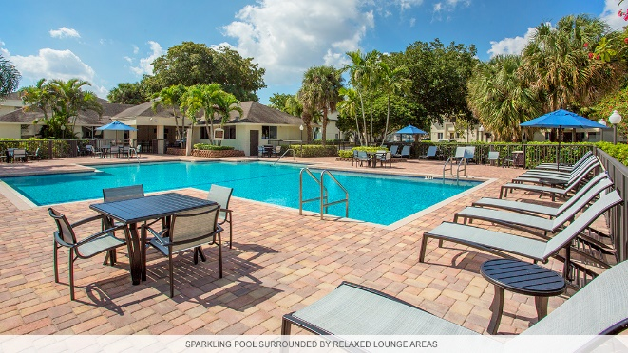
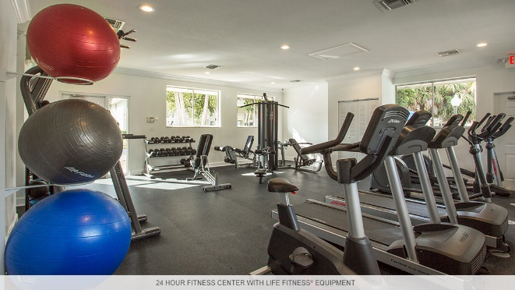
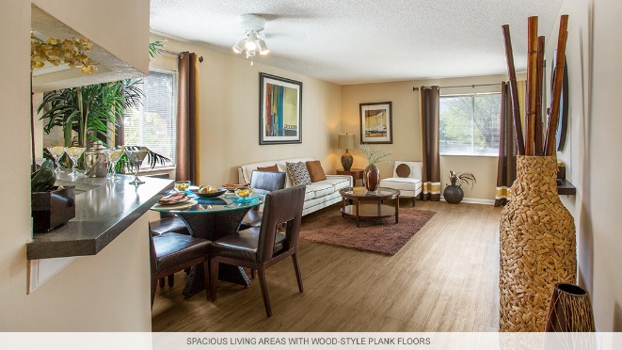
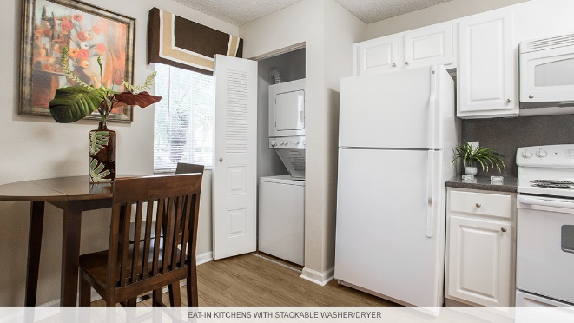
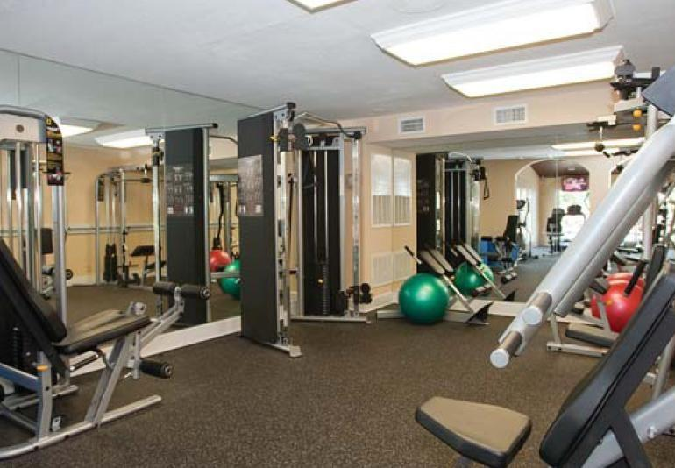
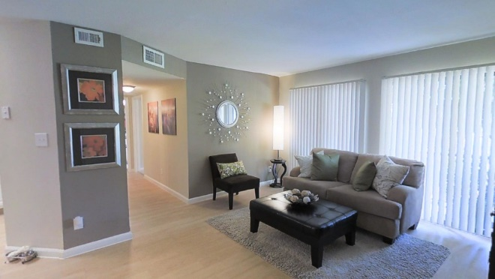
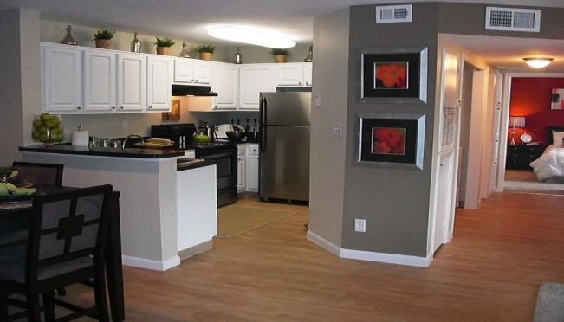
///// STUDENT HOUSING /////
BLUE ISLE APARTMENTS
LAKES OF MARGATE APARTMENT HOMES

Slide 5
///// TUITION /////
TUITION INFO
*VSM Full-Time Tuition is $3,000/Year or $250/mo for 12 mos.
*VSM Part-Time Tuition is $1,200/Year or $100/mo for 12 mos.
​​Full Seminary Package is ONLY $600/mo for 12 mos.
Tuition is to be paid electronically every first Tuesday of
the month. Please ask us about our marital discounts.
*Not including additional housing fee.
DIFFERENT PACKAGES
Full Seminary Package (VSM & Housing)
Hybrid Class Package (Online & VSM)
Full-Time Package (VSM)
Part-Time Package (VSM)

Slide 6
///// SEU /////
SOUTHEASTERN UNIVERSITY
HOW IT WORKS
Southeastern University in Lakeland, Florida partners with Vine Church to host an instructional site on our church campus. Southeastern University offers excellent college education for an affordable price and is regionally accredited.
SEMESTER BREAKDOWN
Spring Semester: January 6th- May 10th
Fall Semester: August 19th- December 17th
DEGREE PROGRAMS
The following degree programs are offered at Vine Church in partnership with Southeastern University:
Associate of Arts, General Education
Associate of Ministerial Leadership

Slide 7
///// SEU /////
SOUTHEASTERN UNIVERSITY
SEU TUITION
SEU Tuition is $6,600/Year or $3,300/Semester
SEU Technology Fee is $200/Year
SEU offers the church-based extension site program at a reduced tuition rate. Tuition is charged at a rate of $275 per credit hour. Therefore, a full-time student would be charged $3,300 per semester for 12 credit hours (or $6,600 annually for 24 credit hours).
FINANCIAL AID
Because Southeastern University is a regionally accredited institution, its partnership with Vine School of Ministry enables enrolled students to pay for their college experience using federal financial aid (based on eligibility). More information available at: partners.seu.edu/financial-aid-steps

Slide 8
///// STUDENT LIFE /////
TUESDAY
07:30AM – 08:30AM: Prayer
08:45AM – 10:00AM: Class 1
10:10AM – 11:25AM: Class 2
11:30AM – 12:30PM: Office Hour
WEDNESAY
07:30AM – 08:30AM: Prayer
08:45AM – 10:00AM: Class 1
10:10AM – 11:25AM: Class 2
11:30AM – 12:30PM: Office Hour
*Must serve at the building at least one night in the week from 7:30PM – 9:00PM.
THURSDAY
07:30AM – 08:30AM: Prayer
08:45AM – 10:00AM: Class 1
10:10AM – 11:25AM: Class 2
11:30AM – 12:30PM: Office Hour
FRIDAY
07:30AM – 08:30AM: Prayer
08:45AM – 10:00AM: Class 1
10:10AM – 11:25AM: Class 2
11:30AM – 12:30PM: Office Hour
*Must participate in Life Groups & discipleships.
SATURDAY
06:00PM – 07:00PM: Ministry Teams
07:00PM – 07:30PM: Happy Half Hour
07:30PM – 09:00PM: Enjoy Service
SUNDAY
09:30AM – 10:30AM: Ministry Teams
10:30AM – 12:00PM: Sunday Service

Slide 9
///// FAQ /////
WHAT IS THE APPLICATION FEE?
As of 2015 we do not require a registration or application fee but a $100 non-refundable fee is required upon approval of your application.
WILL I NEED A CAR?
Having a car will be up to your personal preference. You will not be required to own one for school.
SHOULD I BRING A LAPTOP?
Yes, a laptop or desktop computer will be important to your experience as a student.
CAN YOU COME AS A MARRIED COUPLE?
Yes, we allow married students as long as their spouse is in full agreement of the decision.

Slide 10
///// MARK YOUR CALENDARS /////
MAY 3
INTEREST GATHERING
JUNE 30
APPLICATION & DEPOSIT DEADLINE
*Second payment will be due September 4th.
AUGUST 7
FIRST PAYMENT DUE*
SEPTEMBER 4
NEW STUDENT ORIENTATION DAY

